Slide 1

PRINCIPLES SOURCES OF CODE OPTIMIZATION
FACULTY INCHARGE : PROF.KANNADASAN R
TEAM MEMBERS :
RAHUL PRASAD U (19MID0004)
MOTHISHWARAN C (19MID0017)
PRASHANTH S (19MID0020)

Slide 2
Code optimization
When a Source code is translated to target code , in between Intermediate code is used to translate the source code into the machine code. These codes may be slow and need extra space.
So what are we aiming at ?
Remove redundant code without changing the meaning of program in order to overcome slowness and extra space needed for them
How can it be achieved ?
Through some code transformation. These transformations are called Optimization.
These are the techniques, which tries to improve the intermediate code by making it consume fewer resources (i.e. CPU, Memory) so that faster-running machine code will result.

Slide 3
Objectives
Code optimizing process should meet the following objectives :
The optimization must be correct, it must not, in any way, change the meaning of the program.
Optimization should increase the speed and performance of the program.
The compilation time must be kept reasonable.
The optimization process should not delay the overall compiling process.

Slide 4
Types of optimization
Optimization
Machine Independent Machine dependent
Transformed here does not involve any CPU registers or absolute memory locations.
Transformation involves CPU registers and may have absolute memory references rather than relative references
It takes much effort to use
maximum advantage

Slide 5
Principle source of optimization
The principle steps involved in optimization are,
Common sub expression elimination
Copy propagation
Dead code elimination
Constant folding
Loop optimization
1. Code Motion
2. Reduction in Strength
3. Induction-Variable elimination

Slide 6


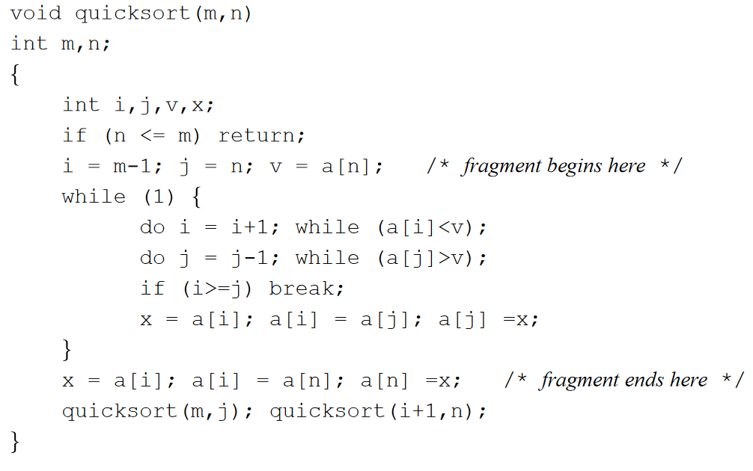
QuickSort: Example program

Slide 7
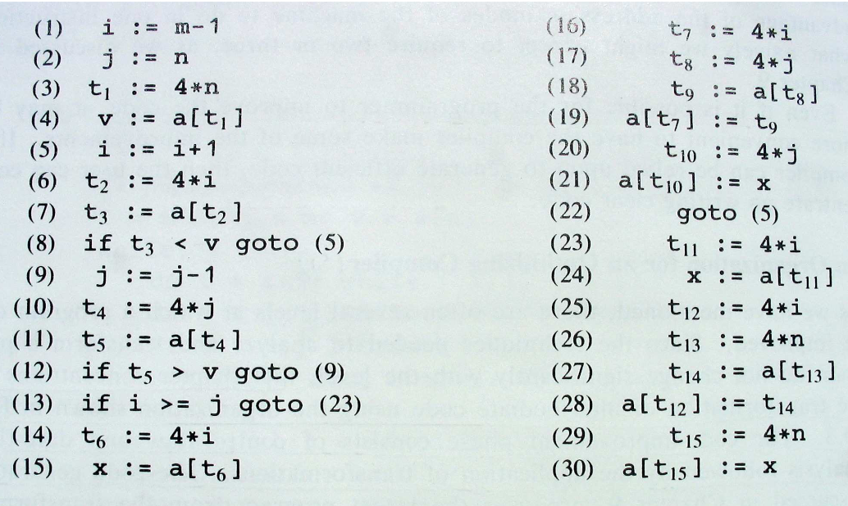
Quicksort: ExampleProgram(Cont.)
The following is the three-address code for a fragment of Quicksort.

Slide 8
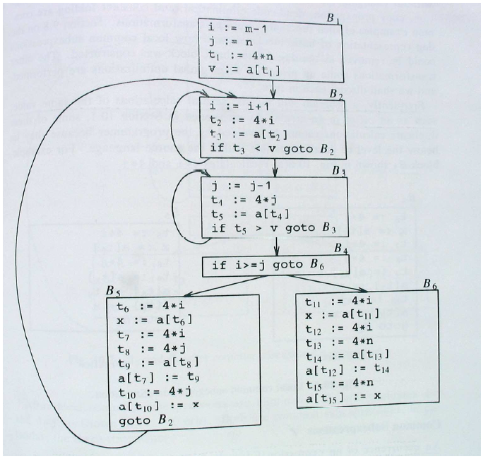
Flow graph for the three-address code
fragment for quicksort.
Each B_{i} is abasic block.

Slide 9
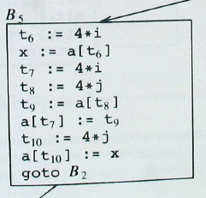
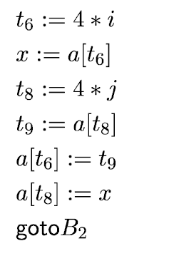
1.Common Subexpression Elimination
Frequently a program will include calculations of the same value.
An occurrence of an expression E is called a common subexpression if E
was previously computed, and the values of variables in E have no changed since the previous computation.
Example. Consider the basic block B₅. The assignments to both t₇ and
t₁₀ have common subexpressions and can be eliminated.
After local common subexpression elimination,
B₅ is transformed as:

Slide 10
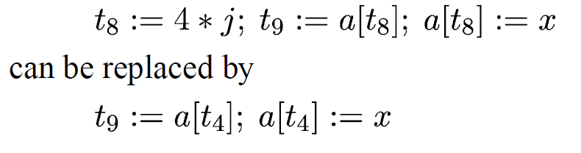
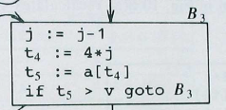
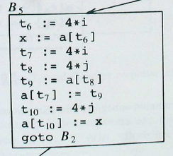
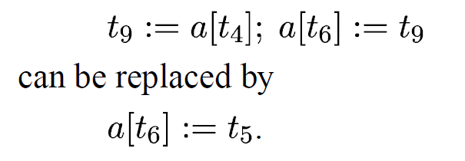
After local elimination B₅, still evaluates 4*i and 4*j which are common subexpressions. 4*j is evaluated in B₃ by t₄ . Then, the statements can be replaced by
Now, a[t₄]is also a common subexpression, computed in B₃ by t₅ .
Then,the statements
.
Analogously, the value of x is the same as the value assigned to t₃ in block
B₃; while t₆ can be eliminated and replaced by t₂

Slide 11

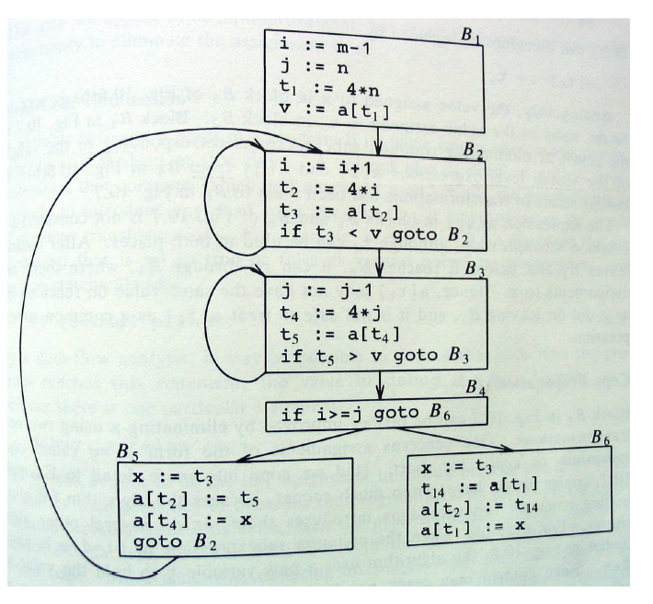
The following flow graph shows the result of eliminating both
Local and global common subexpressions from basic blocks B₅ and B₆.

Slide 12
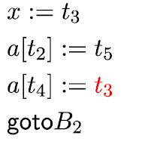
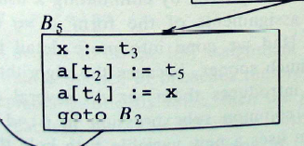
2.Copy Propagation
Rule:
Given the copy statement x := y use y for x whenever possible after the copy statement.
Copy Propagation applied to Block B₅ yields:
This transformation together with Dead-Code Elimination (see next slide)
will give us the opportunity to eliminate the assignment altogether.
Before transformation:

Slide 13
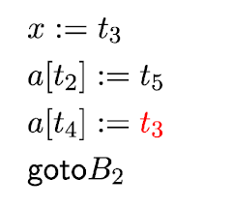
3.Dead-Code Elimination
A variable is live at a point in a program if its value can be used subsequently, otherwise it is dead.
A piece of code is dead if data computed is never used elsewhere.
Dead-Code may appear as the result of previous transformation.
Dead-Code works well together with Copy Propagation.
Example. Considering the Block B₅ after Copy Propagation we can see that x is never reused all over the code. Thus, x is a dead variable and we can eliminate the assignment x:= t₃ from B₅.

Slide 14
4.Constant Folding
Based on deducing at compile-time that the value of an expression (and in particular of a variable) is a constant.
Constant Folding is the transformation that substitutes an expression with a constant.
Constant Folding is useful to discover Dead-Code.
Example:
consider ,
x=2 * 3;
if(x > 5) ---- > while at compile time → if ( 6 > 5 ) | x will be evaluated as 6
{…}

Slide 15
5. Loop Optimization
Loop optimization: Programs spend 90% of time in 10% of code. (Mostly in loops) so it makes sense to optimize this portion of code.
The running time of a program can be improved if we decrease the amount of instructions in an inner loop.
Three techniques are useful:
Code Motion
2. Reduction in Strength
3. Induction-Variable elimination

Slide 16
5.1. Code Motion
If the computation of an expression is loop-invariant this transformation places such computation before the loop.
Example.
Consider the following while statement:
while (i <= limit - 2) do | The expression limit - 2 is loop invariant.
Code motion transformation will result in:
t := limit -2;
while (i <= t) do

Slide 17
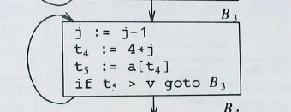
Reduction in Strength
It is based on the replacement of a computation with a less expensive one.
Example.
Consider the assignment in t₄ := 4 * j Block B₃ .
j is decremented by 1 each time, then t₄ := t₄ * j - 4.
Thus, we may replace t₄ := t₄ * j by t₄ := t4 - 4.
Problem: We need to initialize t₄ to t₄ := 4 * j before entering the Block B₃.
Result :
The substitution of a multiplication by a subtraction will speed up
the resulting code.

Slide 18
Induction Variables
A variable x is an Induction Variable of a loop if every time the variable x changes values, it is incremented or decremented by some constant.
A common situation is one in which an induction variable, say i, indexes an array, and some other induction variable, say t, is the actual offset to access the array:
→Often we can get rid of i.
→In general, when there are two or more Induction Variables it is possible
to get rid of all but one.

Slide 19
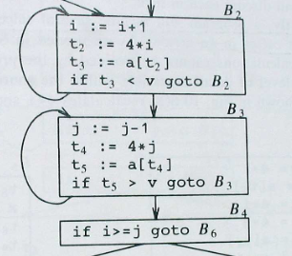
Example.
Consider the loop of Block B₃. The variables j and t₄ are Induction Variables. The same applies for variables i and t₂ in Block B₂ .
After Reduction in Strength is applied to both t₂ and t₄, the
only use of i and j is to determine the test in B₄ .
Since t₂ := 4 * i and t₄ := 4 * j the test t₂ > t₄ is equivalent to i > j .
After this replacement in the test, both i (in Block B₂) and j (in Block B₃)
become dead-variables and can be eliminated!
(see next slide for the new optimized code).
t₂ = t₂+4
t₄ =t₄-4

Slide 20
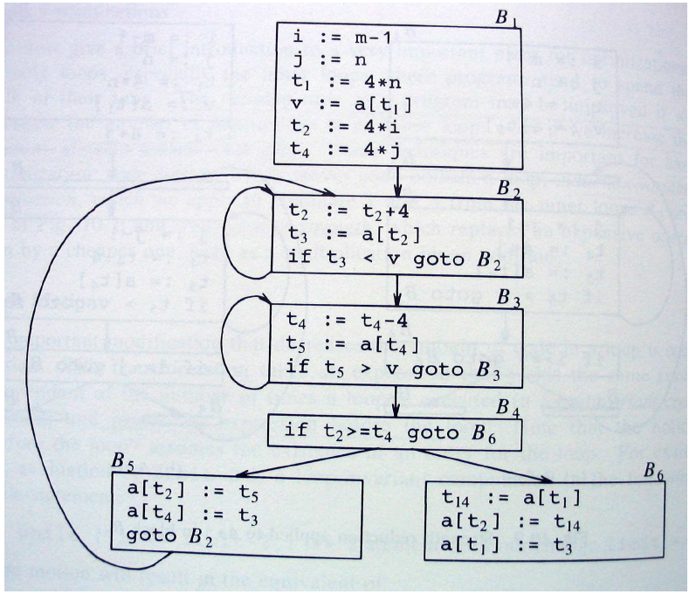
Flow graph after reduction in strength and induction-variables elimination.

Slide 21
Thank You !

